Slide 1
Template for a proposing a new Trust Domain
Rapid Assessment Template for new Trust Domain proposals
04th March 2024

Slide 2
Introduction
Please use this slide to provide a high-level introduction to the proposed Trust Domain. Ensure to include the purpose, rationale and function the proposed Trust Domain will solve for within the GDHCN context.

Slide 3
Trust Domain Definition
A “Trust Domain” is defined by a set of:​
Defined use cases and business processes related to the utilization of Verifiable Digital Health Certificates ​
the open, interoperable technical specifications that define the applicable Trusted Services and Verifiable Digital Health Certificates for the use case​
References to a set of policy and regulatory standards* describing expected behavior of participants for to the use case​
*the policy and regulatory standards are not specified by a trust domain, rather references to such standards should be provided

Slide 4
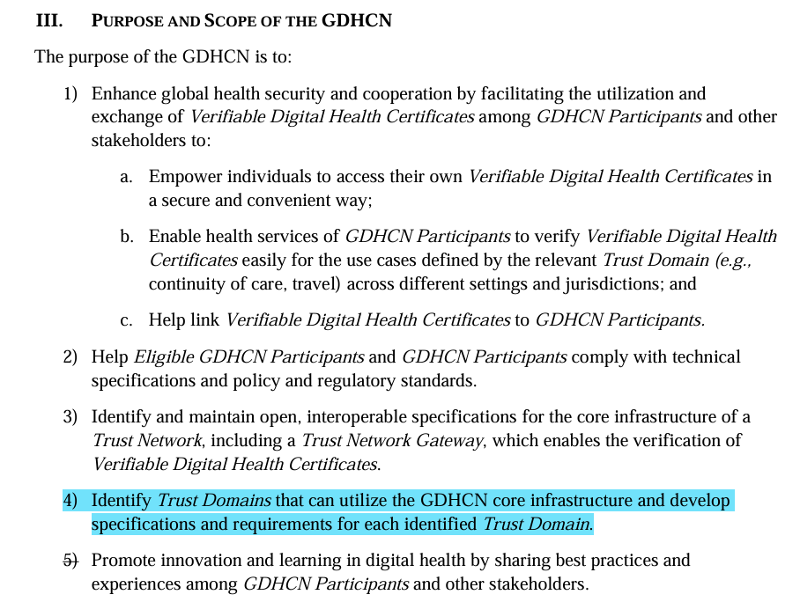
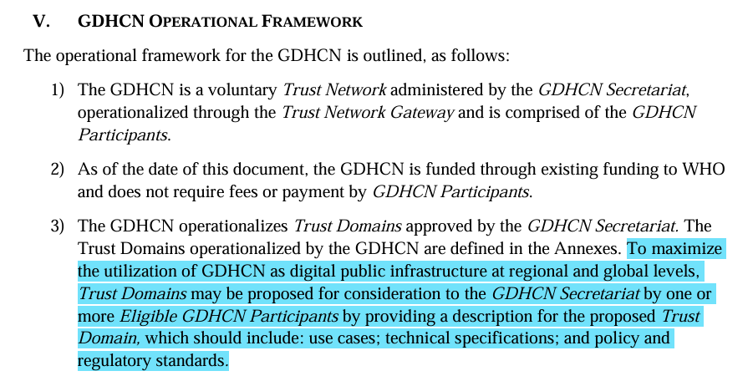
Trust Domains – Administrative Framework
This slide represents a reference to snapshots of the published GDHCN Administration and Operational Framework that highlight identifying new Trust Domains as a core purpose and scope of the GDHCN and that new Trust Domains might be proposed to the secretariat for consideration by any eligible GDHCN participant. For more details, please review the published framework document that can be found here.

Slide 5
Trust Domain Definitions – Use cases and business processes
Please provide specific examples of how the Trust Domain will be applied, with the help of personas, user scenarios and business processes. Please add as many slides as needed to cover all aspects. ​
Reference guidance and examples
Personas depict a generic description of a relevant stakeholder, or end users, who would be interacting with the digital system or are involved in the care pathway. Personas are developed by distilling and synthesizing general characteristics, roles and needs from real settings or interviews with end users​
User scenarios provide a narrative description of the personas interacting with the system within a business process. The user scenario provides a clear understanding of how the system will be used in a story telling format.​
Business Processes are intended to document a set of related activities or tasks performed together to achieve the objectives of the health programme area, such as registration, counselling, etc. Workflows are used to visually represent the progression of activities (tasks, decision points, interactions) that are performed within the business process ​
Example: DDCC Use cases​

Slide 6
Trust Domain Definitions – Technical Specifications
Detail the technical requirements, emphasizing data standards, interoperability and security protocols, informed by the core data elements essential for digital health systems.
Reference guidance and examples
Provide definitions of the semantic and syntactic data structures for data exchange. Ideally the specifications already exist.
Example specifications
WHO Digital Documentation of COVID-19 Certificates (DDCC)
International Patient Summary
EU HCert Digital Covid Certificate QR code
International Patient Access
International Classification of Diseases
LOINC

Slide 7
Trust Domain Definitions – Policy references
Identify and document all relevant legal frameworks, along with key policy principles and requirements specific to the Trust Domain​. Formalize participation through agreements that outline data use, privacy terms, and responsibilities.
Reference guidance and examples
Provide references to policy or governance framework that enables sharing of content
Examples
EU DCC decisions
International Health Regulations (2005)

Slide 8
Related Efforts
Provide information on related collaborations and efforts and/or existing communities of practice.​ Determine if the WHO's GDHCN secretariat is expected to establish a Community of Practice for this Trust Domain.
Reference guidance and examples
Are you aware of any related efforts in terms of development of ongoing specifications through IHE or HL7 or any other communities of practice that are interested in similar use cases?
Any upcoming existing connectathons or testing events?

Slide 9
Annexes

Slide 10
Annex 1: High-level process guidance for establishing a newly proposed Trust Domain
Complete the Rapid Assessment Template to detail the comprehensive scope and objectives of the new Trust Domain, ensuring alignment with the GDHCN's overarching goals.
Collaborate with the WHO's secretariat in a joint effort to engage a diverse group of stakeholders from various sectors and disciplines, aiming to gather comprehensive insights and feedback for the development of the new Trust Domain.
Develop detailed technical specifications and policy standards, adhering to GDHCN’s guidelines and international best practices.​
Establish a robust governance structure, clarifying roles, responsibilities and decision-making processes.
Set up a secure, scalable, and interoperable IT infrastructure, tailored to the Trust Domain's specific needs.​
Conduct thorough testing to validate technical and operational effectiveness, ensuring readiness for deployment.​
Collaboratively implement a pilot phase with the WHO's secretariat to test processes in a controlled environment, facilitating joint adjustments before the full-scale launch.
Jointly launch the Trust Domain with the WHO's secretariat, ensuring comprehensive training and resources are provided to all participants for a seamless transition.
In partnership with the WHO's secretariat, institute ongoing mechanisms for monitoring, evaluation, and adaptation to maintain the Trust Domain's effectiveness and relevance over time.

Slide 11
Annex 2: High-level guidance for documenting the Trust Domain as a FHIR Implementation Guide
The Trust Domain shall try to align to the SMART Guidelines methodology of documenting a FHIR Implementation Guide. The L3 SOP provides a comprehensive guidance for the same, including guidance for development, testing, and production considerations.
Start a new GitHub repository using this repository as a template
Translate the identified use cases, specifications and the policy in previous slides into Business Requirements tab of the FHIR Implementation Guide
input/pagecontent/trust_domain_policy.md​
input/pagecontent/trust_domain_specifications.md​
input/pagecontent/trust_domain_use_cases.md​
input/pagecontent/personas.md​
Input/pageconent/scenarios.md​
input/pagecontent/business-processes.md​

Slide 12
Annex 2: High-level guidance for documenting the Trust Domain as a FHIR Implementation Guide (continued)
Translate the functional components to Data Models and Exchange tab of the FHIR Implementation Guide
Personas are documented as System Actors​
input/pagecontent/system-actors.md​
Workflows are further detailed using UML notation into sequence diagrams and transactions​
input/pagecontent/sequence-dragrams.md​
Input/pagecontent/transactions.md​
Author FHIR resources as needed and detailed in the SOP here​
​At a minimum, Logical Models are required to be authored
Examples​: DDCC

Slide 13
Annex 3: GDHCN Key Links & Resources
Overview of the Global Digital Health Certification Network
Onboarding process
https://www.who.int/initiatives/global-digital-health-certification-network
https://smart.who.int/smart-trust/concepts_onboarding.html
https://www.who.int/news/item/05-06-2023-the-european-commission-and-who-launch-landmark-digital-health-initiative-to-strengthen-global-health-security
tng-secretariat@who.int
Secretariat email for onboarding
Secretariat email for technical support questions
tng-support@who.int
Technical specifications
https://worldhealthorganization.github.io/smart-trust/index.html
Press release announcing the launch of the GDHCN and collaboration with the European Commission

Slide 14
Thank you

